Slide 1


Slide 2




(GROUP NO. )
Mini-Project 2B
Department Of Information Technology
Semester: VI
Div: A
Branch: TE.IT
Academic year-(2022-23)

Slide 3


Slide 4
{Academic year 2022-23}
Pravah streaming website
T.E – I.T Engineering
Group Members:
PRATHAMESH NAIK 20104061
AVINASH ANDHALE 20104138
VISHNUKANT MULE 20104065
Under the Guidance of
Prof. Sonal Jain

Slide 5
Contents
Introduction
Objectives
Scope
Literature survey
Proposed System
Algorithm Used
Project Outcomes
Technology Stack
Block Diagram

Slide 6
INTRODUCTION:
Streaming: The technology of transmitting audio and video files in a continuous flow over a wired or wireless internet connection.
Goal of this mini project is to develop a streaming website with a recommendation system that provides a unique and personalized viewing experience for users
The recommendation system will be built using machine learning algorithms, such as collaborative filtering and content-based filtering.
The website will have a user management component that handles user registration, login, and account settings, and a media management.

Slide 7
Problem Statement:
Online streaming services have become increasingly popular over the past few years, providing users with a vast selection of movies and TV shows. However, with so many options available, it can be overwhelming for users to find content that suits their preferences.
As a result, the problem that needs to be addressed is how to create a streaming website that not only offers a diverse selection of content but also provides personalized recommendations to each user based on their viewing history, preferences, and behavior.
The goal is to design and develop a user-friendly streaming website that utilizes recommendation algorithms to help users discover new and relevant content, while also providing them with a seamless viewing experience.

Slide 8
SCOPE:
Online video streaming.
Data Visualization*
Recommendation system
Free of cost streaming services
Child restriction system*

Slide 9
OBJECTIVES:
To build an User friendly online streaming website.
To provide entertainment platform for source TV shows, movies, serials, and etc.
Providing a streaming websites which totally free of cost which has free subscription.
Implementing recommendation algorithms that use user data, such as viewing history, preferences, and behavior.
The user can register & create a account through Email and can login through the credential’s.
To let the user have a login user id and password to secure their account.

Slide 10
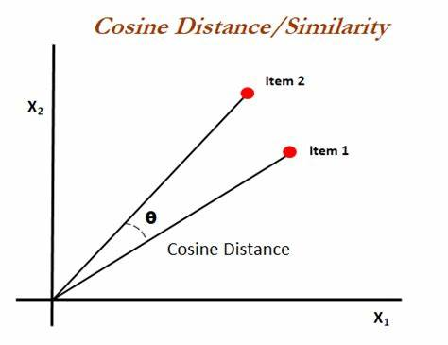
ALGORITHM USED
Cosine similarity is a metric used to measure how similar the documents are irrespective of their size. Mathematically, it measures the cosine of the angle between two vectors projected in a multi-dimensional space.

Slide 11
Proposed System (Features & Functionalities)
User registration and login
User profile
Media content
Recommendation engine
Search and filtering
User ratings and reviews
Watchlist
Subscription management
Like comment and share buttons.
Analysis

Slide 12
Literature Survey:
Keywords:
Scalable Video Coding, Adaptive Video Streaming, Mobile Networks, Social Video Sharing, Cloud Computing
Sr.no | Title | Author(s) | Year | Outcomes | Methodology | Result
1. | The Netflix Effect: | Sidneyeve Matrix | December 2014 | shows opts to view them via Netflix | Experimental study | Successful
2. | YouTube phenomenon | Lucila Dughera | February 2018 | describe the practices of the creators of educational content | Experimental Project research | Successful

Slide 13
PROJECT OUTCOMES:
User can register and login themselves
Improved user engagement, retention and experience
The user can watch the movies and content media as per interest
Media contains the varieties of movies, devotional, cartoons, series, inspirational video
The user will have recommendation updates as per their interest according to their watch history & preferences.
The User can also submit their grievance and feedbacks.*

Slide 14
TECHNOLGY STACK:
HTML
Node JS
CSS
REACT
Media server cloudinary
Database Mongo-DB
ML (Visual Studio)

Slide 15
BLOCK DIAGRAM:
MASTER PAGE
Registration
Login
OTP confirmation
Administration
Select language content
User dashboard
User complaint
Videos responses
Live Broadcast
Generation
User Data
Complaint &
Suggestion
Movies
Form
Audio Songs

Slide 16
WORKFLOW
Data Collection and pre-processing
Data loading and understanding the data
Vectorization
Similarity metric
Getting input from the user
Model Prediction

Slide 17
Use Case Diagram:
REGISTRATION
LOGIN
View Movies
LIKE AND COMMENTS
LOGOUT
USER

